Slide 1
Health BUDDY
Hack O’ Hollics Presents
Always here to Help !!
By:-Harsh Sharma
Shreyam Chaudhary
Mahak Soni

Slide 2
ABOUT US
Here we are representing a health app which provides personalized care to improve outcomes. Humans are social species. So interaction with people is an important part of life. But since past two years the whole world is facing isolation due to coronavirus. There is sudden increment in the mental health issues.
Heal Buddy is an app that interact with user and with the help of language processing predicts if the person is suffering from depressive disorder, anxiety, suicidal thoughts etc. and provide recommendation for therapist and psychiatrist nearby the user and can also book appointment on users behalf.

Slide 3
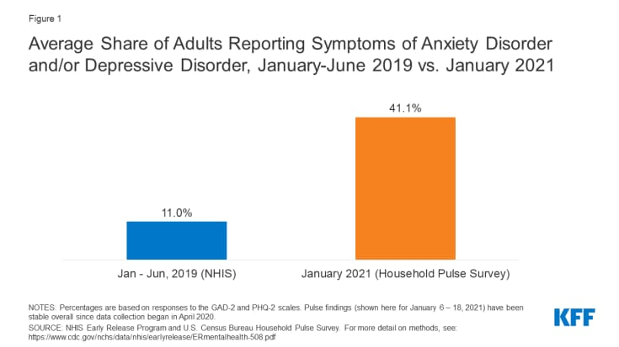
PROBLEM
Humans are social species. So interaction with people is an important part of life. But since past two years the whole world is facing isolation due to coronavirus. There is sudden increment in the mental health issues.
A study estimates increase of about 35% in the prevalence of such disorders in India.
Around 4 in every 10 student is suffering from anxiety in U.S. after the pandemic started.

Slide 4
Solution TO THE Problem
PRODUCT BENEFITS
*It may be impossible for doctors for being available for every patient at some times due to their tight schedule, but here the health care bot is available 24/7.
* Along with this it helps you in various tasks such as reminding you about your medicines, provide medical information, give you tips and overall monitor your recovery rate.
*It will provide us the information regarding its symptoms and the treatment of the coronavirus.
*When the patient will interact with the chatbot, it will answer the questions and can possibly navigate the patients through the process of recovery.
Health Buddy provides help in reaching the therapists and psychiatrists. Through the app the user will able to book appointment and can get in touch with the medical experts to start working on his/her issues.
It will provide you with all the necessary detail you need to know about the medical experts in your close proximity. This app will helps students who are mostly indulge in stress activities throughout the day.

